Slide 1
NLP Project
IIT Bhilai - Query Chatbot
Lahari Sreeja - 12041570
Riyanshi Goyal - 12041240
Yedla Usha Sri - 12041780

Slide 2
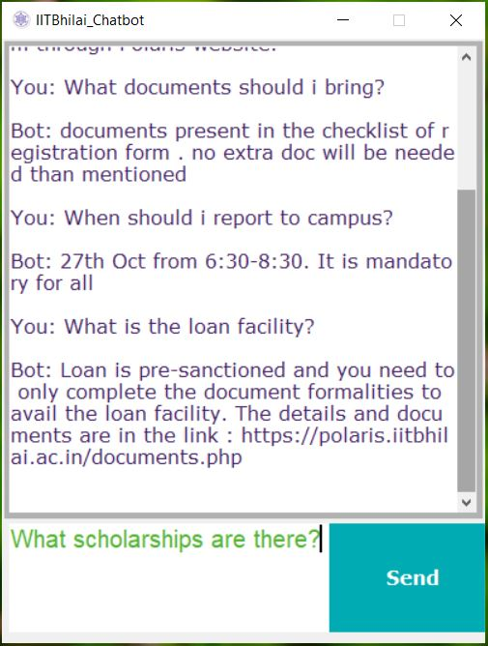
A chatbot is a conversational agent that converses with users in natural language.
It has numerous applications and is also in customer service, call centres,etc. Some of the examples include Apple’s Siri, Amazon’s Alexa, Google Assistant, and Microsoft’s Cortana.They can communicate with people and on social media accounts, as well as on websites.
We have a chatbot that could respond to some basic queries in real-time.
This chatbot helps to solve the queries regarding IIT Bhilai and be very useful especially during the time of admission when there are new students filled with admission regarding queries.

Slide 3
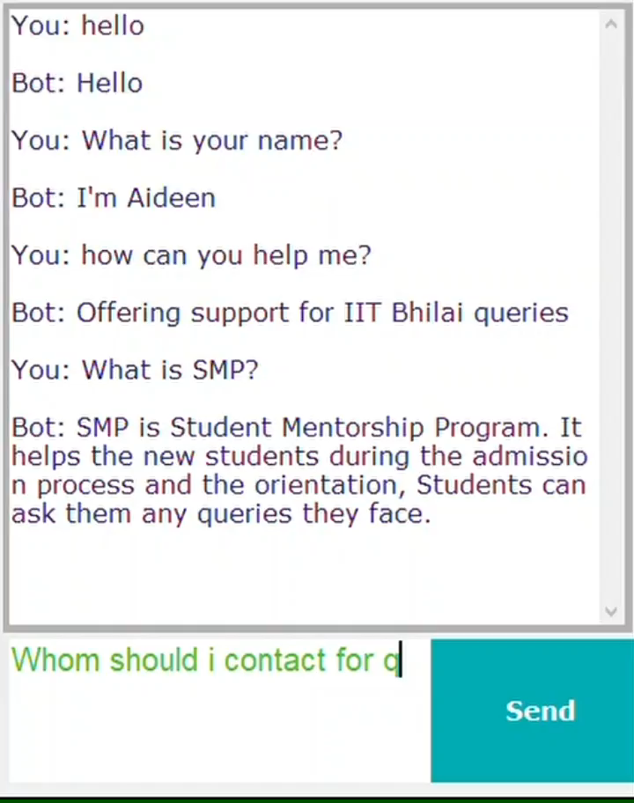
In the end, our chatbot will look like this:

Slide 4
1. Text Preprocessing
It helps to make the data easier for the model

Slide 5
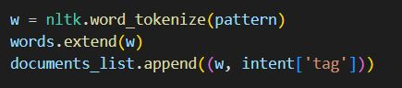
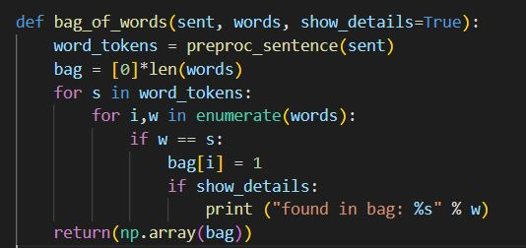
Preprocessing the data we give to the model
Tokenization:
Splitting the data into usable arrays
Lemmatization:
Returning short forms of words
Bag of words(BOWS):
Returns 0 or 1 for each word in the bag that exists in the sentence

Slide 6
2.
Training the Model
Training the model using pre-processed relevant data

Slide 7
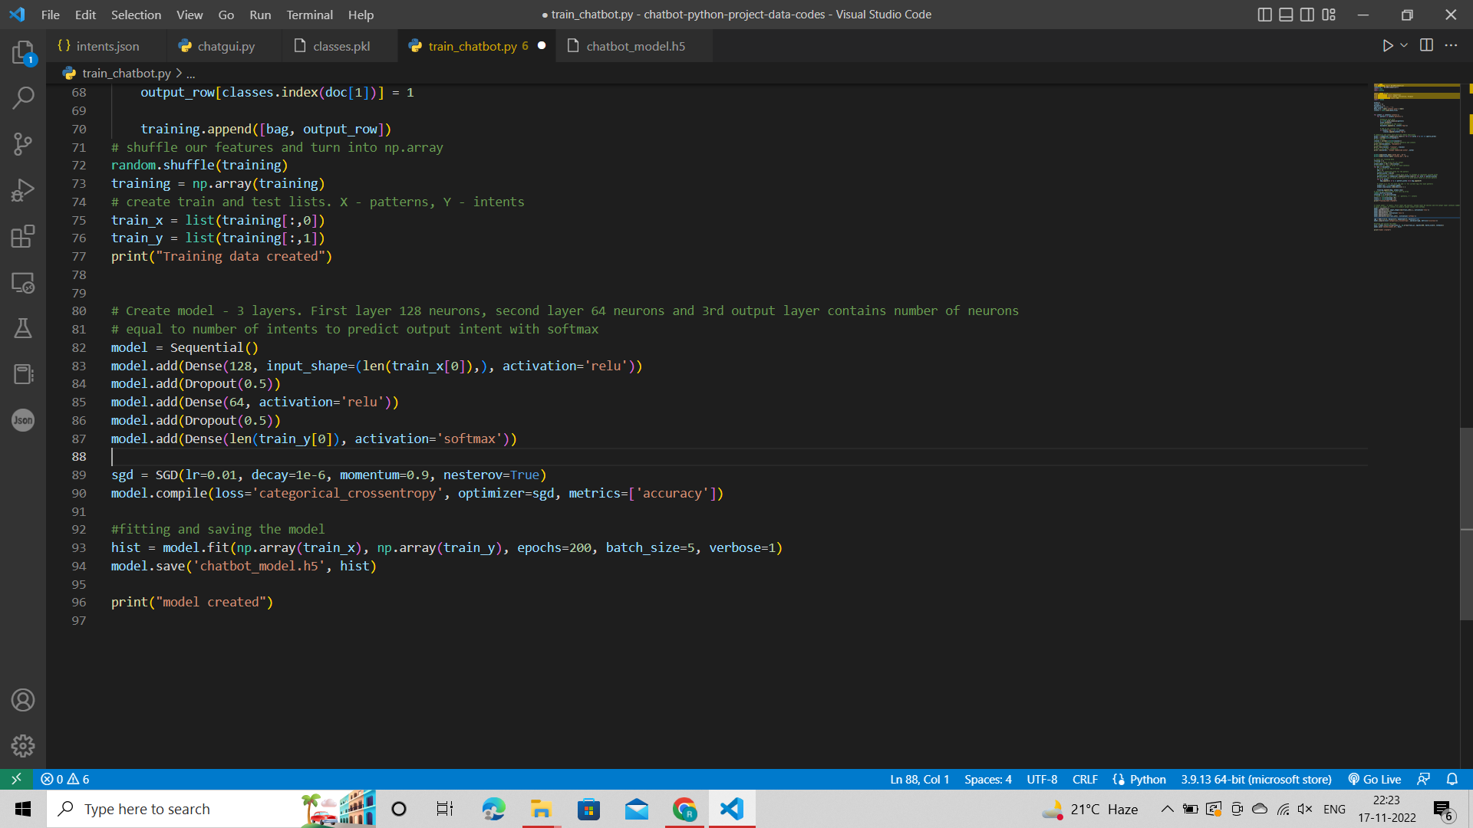
Training the model with pre-processed data
Splitting into train and test:
Shuffle and split data into train and test data
Neural Network model:
Sequential Model based on neuron layers. It has 3 layers with 128,64 neurons in 1st and 2nd layer. SGD is used as the optimizer and Relu as the activation function and softmax activation for the output layer.

Slide 8
Example questions to ask
Who are you?
How can you help?
What is SMP?
Whom can I contact for queries?
When will we shift to the permanent campus?
What documents are needed?
What are the facilities at hostels?
How is the internet at IIT Bhilai?
Tell me about the faculties at IIT Bhilai
What departments are available?

Slide 9
3. Novelty in our Project
Our chatbot is used to solved the queries regarding IIT Bhilai. It is designed to address the doubts faced by the new students during the admission process.
It can be of great help in SMP(Student mentorship program) as our chatbot is an automated program that answers the frequently asked questions and costs nothing.
Thus saving the time of the mentors involved in solving the queries of the new students.

Slide 10
Thanks!

